Slide 1
Internal Incompressible Viscous Flow
By
Dr. S. S. Baral

Slide 2
Outline
Laminar vs turbulent flow and entrance effects
PART A – Fully developed laminar flow
Between infinite parallel plates (stationary / moving)
In a pipe
PART B – Flow in pipes and ducts
Shear stress distribution
Turbulent velocity profiles
Energy considerations in pipe flow
Head loss – calculations
Solution of pipe flow problems
PART C – Flow measurement
Direct methods
Restriction flow meters
Linear flow meters

Slide 3
Laminar vs turbulent flow
Function of Reynolds no
Re = Inertial forces / viscous forces
= (density * average velocity * diameter) / (viscosity)
(For internal flows)
Experimental demonstration
Using a dye and observing its flow pattern
http://www.youtube.com/watch?v=pyk_1Me6H3A
http://www.youtube.com/watch?v=3na9oezJ_Yk&feature=related
Critical Reynolds no (transition to turbulent flows)
Approximately 2300 for flow through pipes

Slide 4
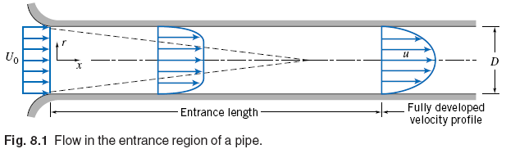
Entrance region
Flow in the entrance region of a pipe
Velocity at the wall must be zero (no-slip condition)
Boundary layer develops along the walls
Fully developed flow (inviscid core disappears)
Entrance length
Laminar flow → L / D = 0.06 * Re (Maximum L = 138 D)

Slide 5
PART A
FULLY DEVELOPED LAMINAR FLOW

Slide 6
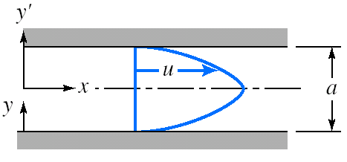
Flow between infinite parallel plates (Both plates stationary)
System – Two infinite (in z-direction) plates separated by a distance ‘a’
Assumption
Fully developed laminar flow → u = u (y)
No variations of fluid properties in ‘z’ direction
Steady and incompressible flow
No component of velocity in y and z directions
Boundary conditions for x-component of velocity

Slide 7
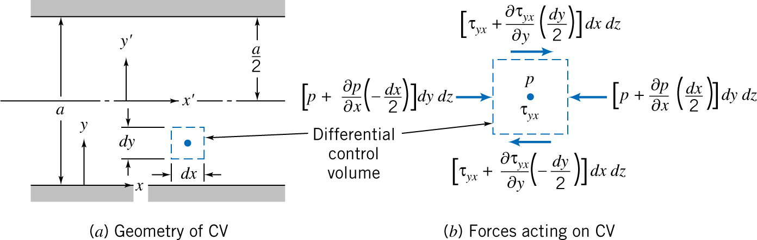
Flow between infinite parallel plates (Both plates stationary)
Objective
To obtain velocity field, shear stress distribution and other flow properties of interest
Solution
Analysis using differential control volume (dV = dx dy dz)
Basic momentum equation

Slide 8
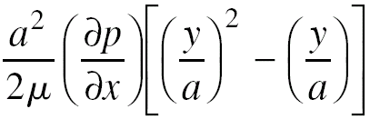
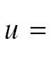
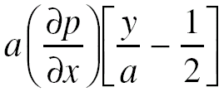
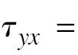
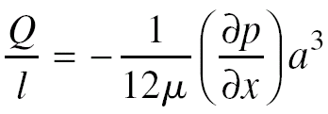
Flow between infinite parallel plates (Both plates stationary)
Velocity profile
Shear stress distribution
Volume flow rate

Slide 9
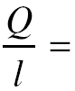
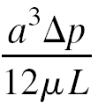
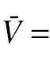
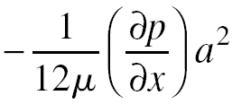
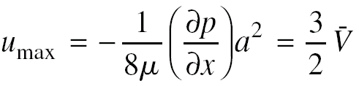
Flow between infinite parallel plates (Both plates stationary)
Flow rate as a function of pressure drop
Average velocity
Maximum velocity (Location)

Slide 10
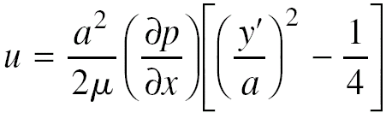
Flow between infinite parallel plates (Both plates stationary)
Transformation of coordinates
Velocity profile for laminar flow between stationary parallel plates is parabolic
All results are valid only for laminar flow
Critical Re for flow between stationary plates is 1400

Slide 11
Flow between infinite parallel plates (Upper plate moving)
Change in boundary conditions
At y = 0 u = 0
At y = a u = U
Velocity profile
Obtain shear stress distribution, volume flow rate, average velocity, maximum velocity (its location)

Slide 12
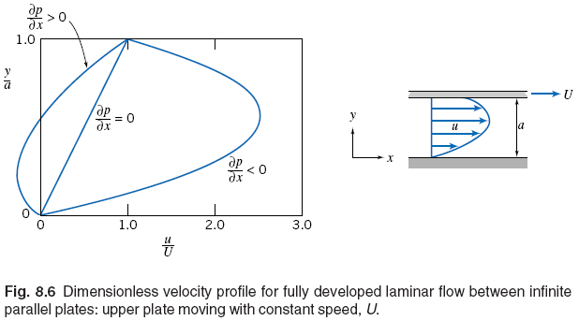
Flow between infinite parallel plates (Upper plate moving)
Dimensionless velocity profile
Effect of pressure gradient
Couette flow (when pressure gradient is zero)
All results are valid only for Laminar flow

Slide 13
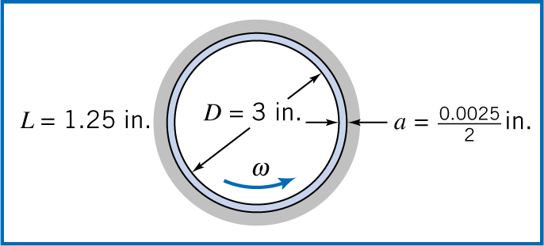
Example – Torque and power in a journal bearing
Crankshaft journal bearing in an automobile engine lubricated by SAE 30 oil (99C)
L=31.8 mm
a=0.0635 / 2
w = 3600rpm
No load on bearing
clearance is symmetric
Determine torque required and power dissipated

Slide 14
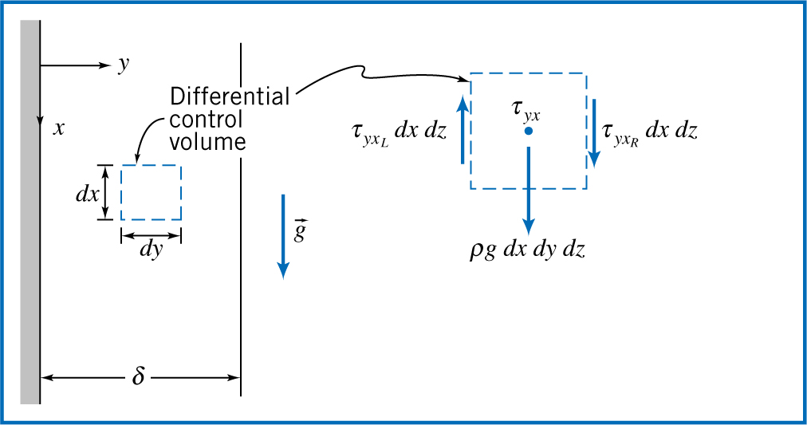
Example – Laminar film on a vertical wall

Slide 15
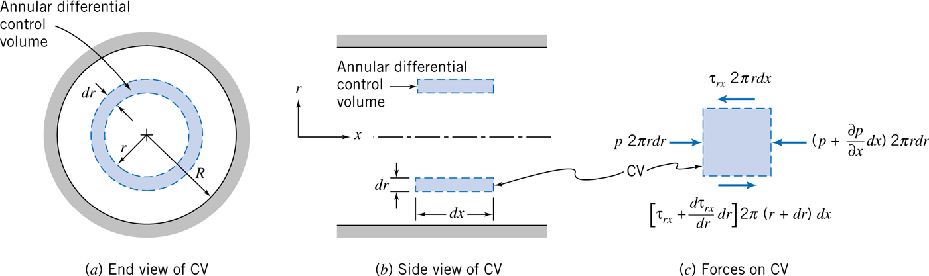
Fully developed laminar flow in a pipe
Steady flow
Cylindrical coordinates
Using differential control volume and basic momentum equation

Slide 16
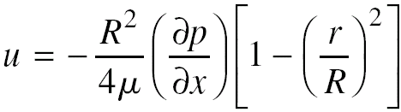
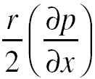
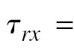
Fully developed laminar flow in a pipe
In a constant diameter pipe pressure drops uniformly along the pipe length (except in entrance region)
Velocity profile
Shear stress distribution

Slide 17
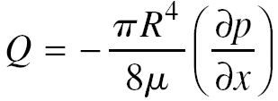
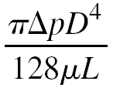
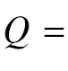
Fully developed laminar flow in a pipe
Volume flow rate
Flow rate as a function of pressure drop
Hagen-Poiseuille’s equation

Slide 18
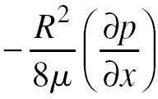
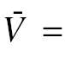
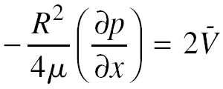
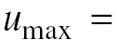
Fully developed laminar flow in a pipe
Average velocity
Maximum velocity

Slide 19
PART B
FLOW IN PIPES AND DUCTS

Slide 20
Pressure in the pipe flow
Three factors that tend to reduce pressure in a pipe flow
A decrease in pipe area
An upward slope
Friction
Horizontal pipe (focus of study)
Frictional losses
Major loss (constant area sections of the pipe)
Minor loss (due to fittings/restrictions)

Slide 21
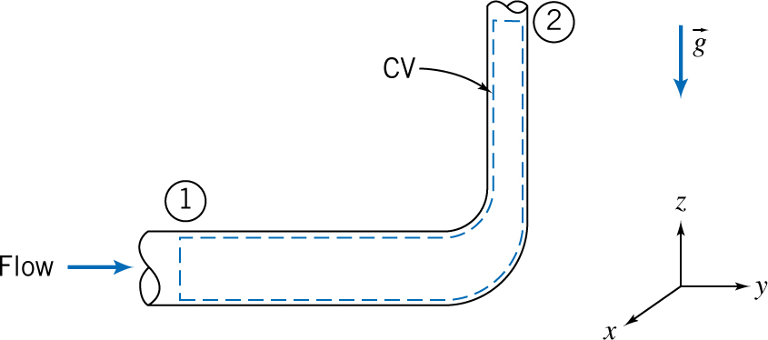
Energy considerations in pipe flow
EGL
Constant in case of frictionless flow (inviscid fluid flow)
Will continuously decrease in the direction of fluid flow because of friction (which reduces mechanical energy)
Energy equation (pipe flow – reducing elbow)

Slide 22
Energy considerations in pipe flow
Assumptions
Shaft work = 0
Other work = 0
Shear work = 0
Steady
Incompressible flow
Internal energy and pressure uniform across inlet and outlet
Energy equation (non-uniform velocity)

Slide 23
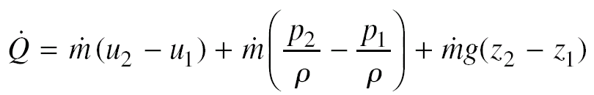
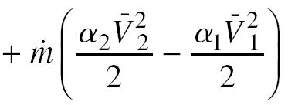
Energy considerations in a pipe flow
Kinetic energy coefficient
Laminar flow
Turbulent flow
Energy equation (using kinetic energy coefficient)

Slide 24
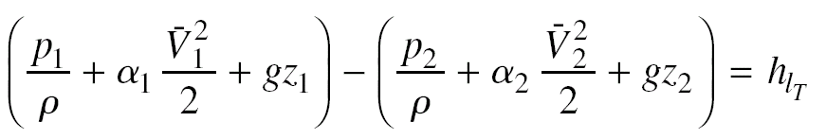
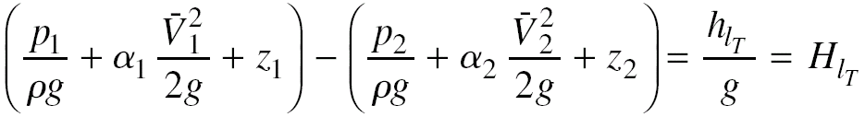
Energy considerations in a pipe flow
Head loss
Dividing energy equation by mass flow rate and rearranging
Most important and useful equations in fluid mechanics
To determine mechanical energy loss due to friction
To determine pressure difference if head loss can be calculated

Slide 25
Calculation of head loss
Total head loss
Major losses – friction effects in fully developed flow in constant area tubes
Minor losses – results from fittings, area changes, entrances, etc.
Major losses (constant area horizontal tube)
Δ p/ ρ = major losses (energy)
Laminar flow
Turbulent flow

Slide 26
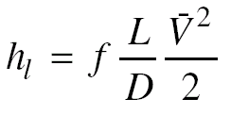
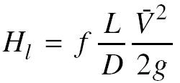
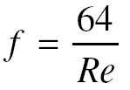

Calculation of head loss – Major losses
Laminar flow friction factor
Where,
Turbulent flow friction factor
f = Φ (Re, e/D) (Where e → Roughness factor)

Slide 27
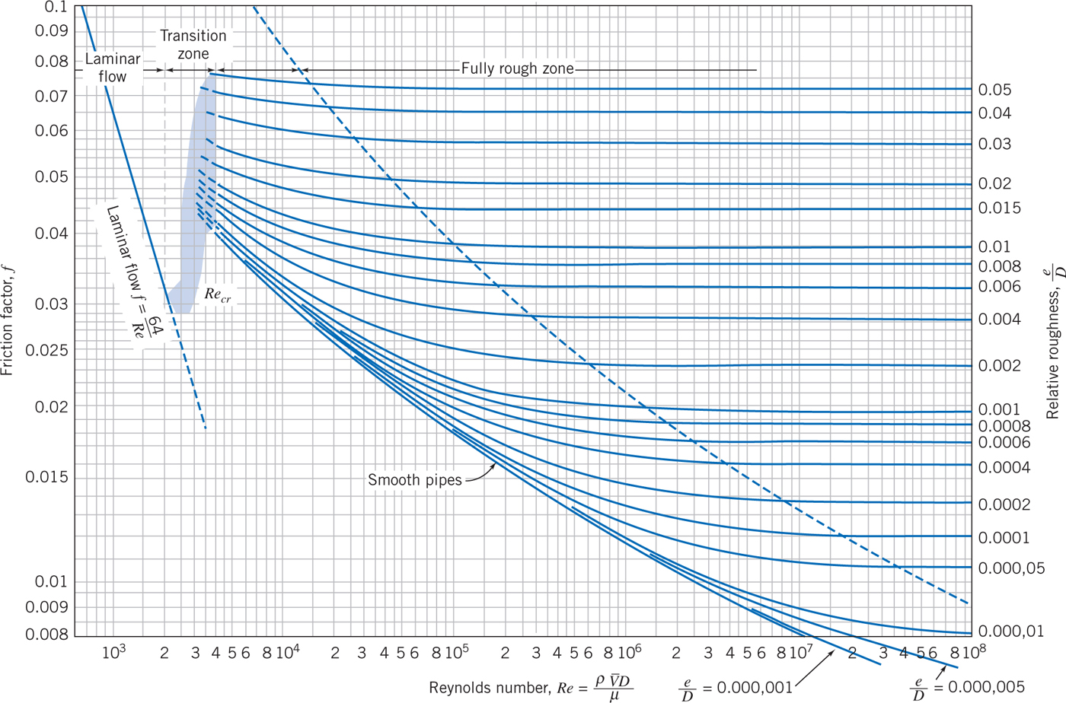
Calculation of head loss – Major losses
Moody’s chart

Slide 28
Moody’s chart - Analysis
Friction factor
Decreases with increase in Re for laminar flow
Increases sharply at transition
Decreases gradually with increase in Re for turbulent flow regime
Remains constant for large Re
Actual energy loss (h_{l})
Proportional to average velocity for laminar flow
Suddenly increases in transition region
Increases at a rate somewhere between V and V² for turbulent flow regime
Proportional to V² for fully rough zone

Slide 29
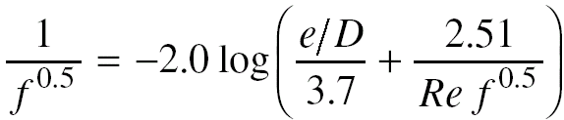
Calculation of head loss – Major losses
Turbulent flow friction factor (empirical expressions)
Colebrook (Re > 2300)
Halland’s expression
Re > 3000
No need of iterations
For smooth pipes – Blasius equation (Re <10⁵)
Wall shear stress expression can be obtained.

Slide 30
Calculation of head loss – Minor losses
Additional head losses primarily because of flow separation/secondary flow
Energy losses because of fittings, bends, changes in area
Examples – Inlets/Exits, sudden expansion, sudden contraction, valves, elbow , T-fittings

Slide 31
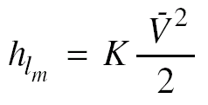
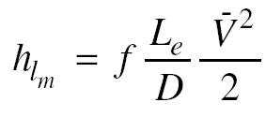
Calculation of head loss – Minor losses
Minor losses can be computed in either of two ways
OR
where ‘K’ is loss coefficient, L_{e} is equivalent length of straight pipe
Equivalent length
That length of a pipe which will have the same head loss for the same discharge (outlet velocity)

Slide 32
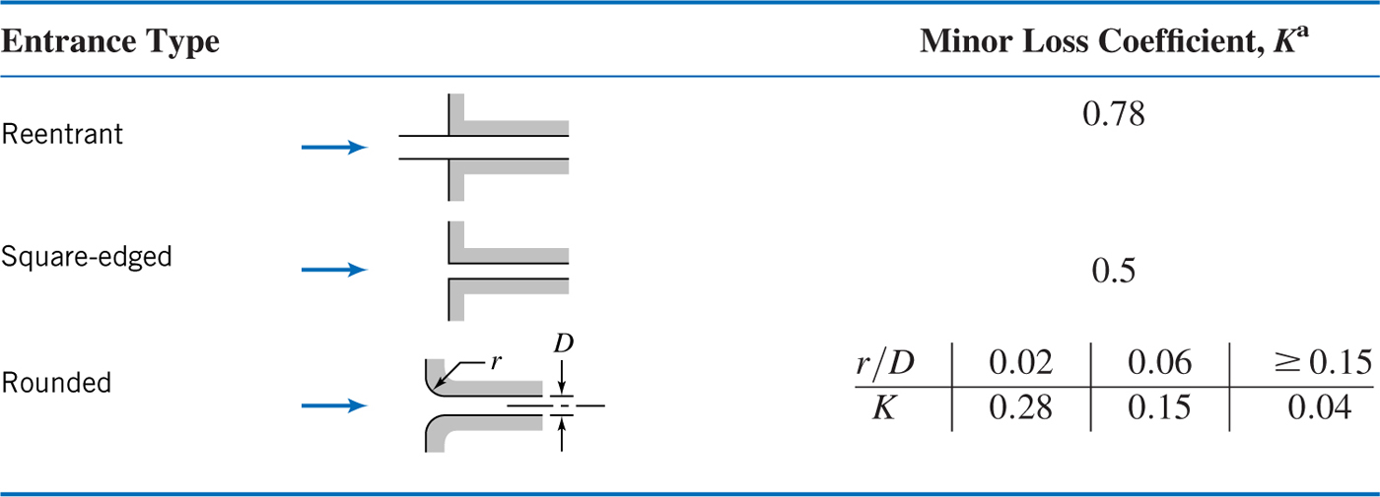
Minor losses – Inlets/exits
Basic inlet geometries
Exits
Diffuser at the downstream can reduce head losses

Slide 33
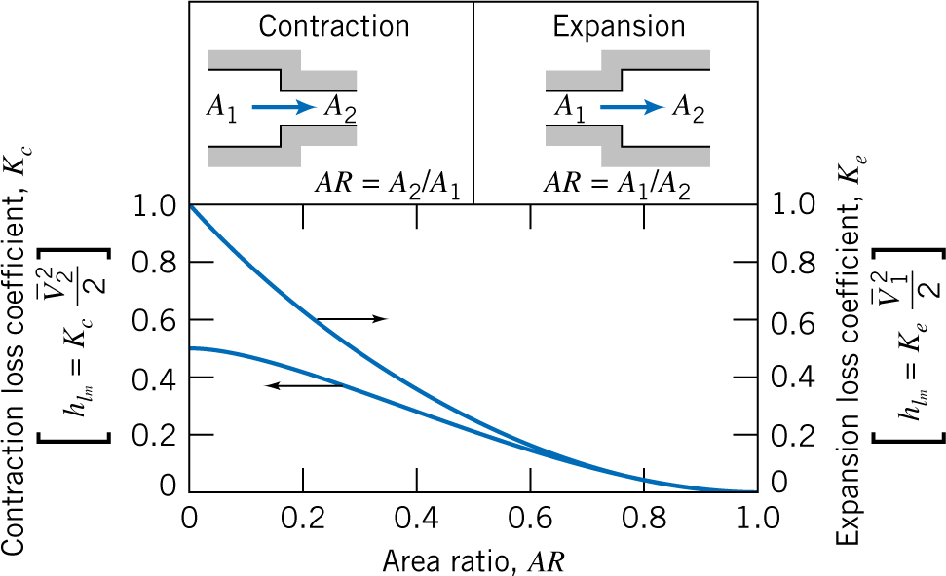
Minor losses – Enlargements/Contractions
Losses caused by change in area
Sudden contraction / sudden expansion
Loss coefficients are based on larger average velocity term and area ratio (AR)

Slide 34
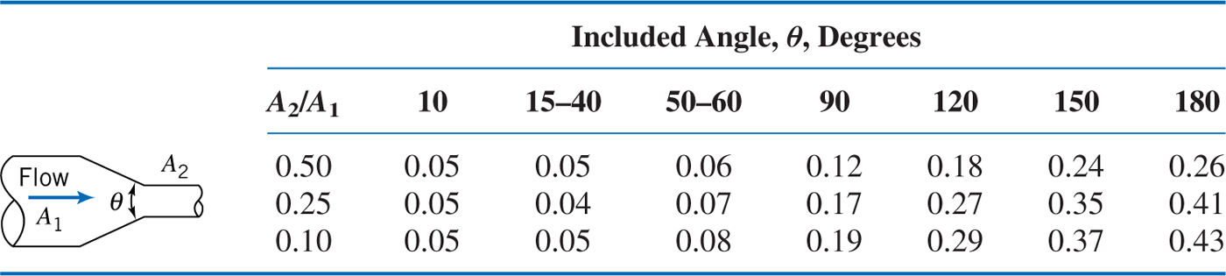
Minor losses – Enlargements/Contractions
Losses in sudden contraction/expansion can be reduced by using nozzles/diffusers
Nozzles (Loss coefficients)

Slide 35
Minor losses – Enlargements/Contractions
Diffusers
Data related to diffuser is commonly presented in terms of pressure recovery coefficient (C_{P})
C_{P} is the ratio of static pressure rise to inlet dynamic pressure
C_{P} for ideal fluid can be related to area ratio
Relation between C_{P} and head loss for conical diffuser (turbulent flow) can be obtained

Slide 36
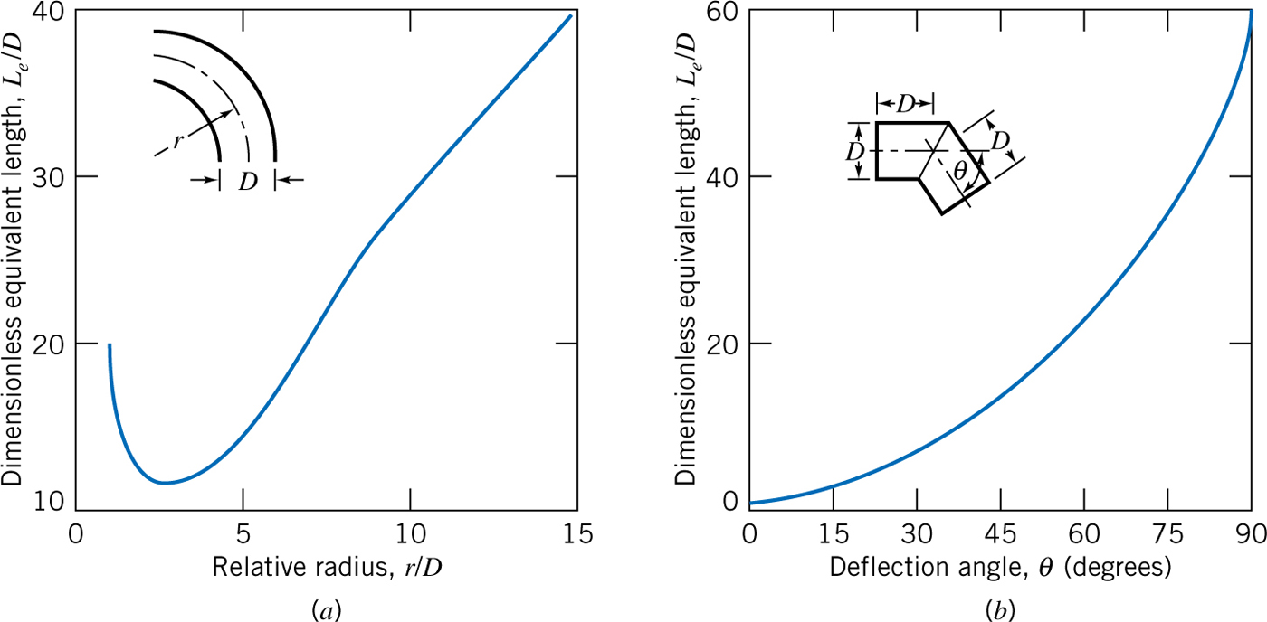
Minor losses – Pipe bends
Head losses are generally are measured using equivalent lengths
Additional head loss is because of the secondary flow

Slide 37
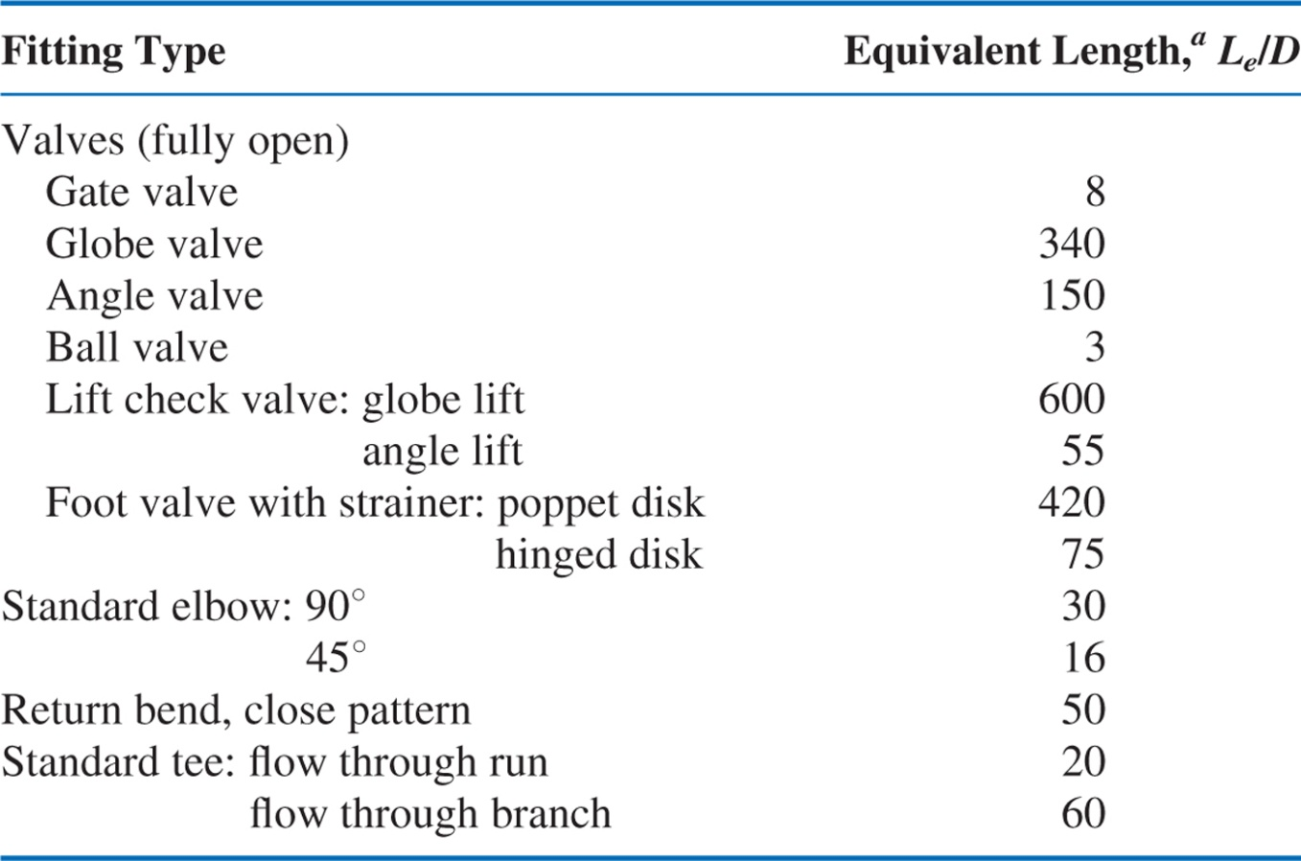
Minor losses – Valves and fittings
Head losses are generally measured in terms of equivalent lengths

Slide 38
Pumps, Fans, and Blowers in fluid systems
Driving force required to maintain the flow against friction is provided by pumps (for liquids), fans and blowers (for gases)
Apply first law of thermodynamics (energy equation) across pump
Pumps add energy in terms of gain in pressure
Head produced by the pump is needed to overcome the head loss for pipe system

Slide 39
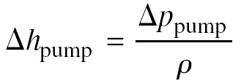
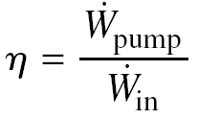

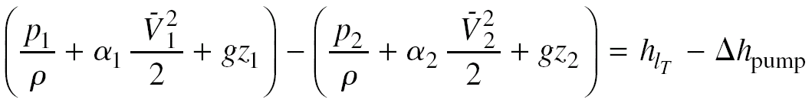
Pumps, Fans, and Blowers in fluid systems
Useful relations (Pump work, head gain by the pump)

Slide 40
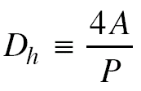
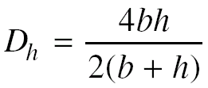
Noncircular ducts
Equations developed for a pipe (circular cross section) can be used for noncircular ducts by replacing diameter with hydraulic diameter
Hydraulic diameter
Hydraulic diameter for rectangular duct

Slide 41






Pipe flow problems - Solutions
Energy equation
Calculation of major losses
Calculation of minor losses

Slide 42
Pipe flow problems - Solutions – Single path systems
Find Δp for a given L, D, and Q
Use energy equation directly
Find L for a given Δp, D, and Q
Use energy equation directly

Slide 43
Pipe flow problems - Solutions – Single path systems
Find Q for a given Δp, L, and D
Manually iterate energy equation and friction factor formula to find V (or Q), or
Directly solve, simultaneously, energy equation and friction factor formula using (for example) Excel
Find D for a given Δp, L, and Q
Manually iterate energy equation and friction factor formula to find D, or
Directly solve, simultaneously, energy equation and friction factor formula using (for example) Excel

Slide 44


Slide 45

Example: Flow in a pipeline (Unknown length)
Crude oil flows through a pipeline
Q = 2.944 m³/s, D = 1.22 m
Roughness is equivalent to galvanized iron
Max allowable pressure = 8.27 MPa
Min pressure required to keep gases in sol^{n} = 344.5 kPa
SG_{Crude} = 0.93, Viscosity (@60⁰ C) = 0.0168 Ns/m²
Determine maximum spacing between pumping stations
If pump efficiency = 85%, find power supplied @ each station

Slide 46

Example: Flow in an irrigation system (Unknown diameter)
Water supply through 152.4 m of drawn tubing from an engine driven pump
Pump discharge = 0.0946 m³/s
Pump discharge pressure = Max 448.2kPa(g)
Sprinkler pressure = Min 206.8kPa (g)
Minor losses and elevation changes are neglected
Determine smallest standard pipe size

Slide 47
PART C
FLOW MEASUREMENT

Slide 48
Flow measurement – Methods and devices
Direct methods
Restriction flow meters for internal flows
Principle
Orifice plate
Flow nozzle
Venturi
Laminar flow element
Linear flow meters

Slide 49
Flow measurement – Direct method
Liquids
Measure the amount of liquid accumulated in a container for a fixed period of time
Gases
‘Bell’ or ‘balloon’

Slide 50

Restriction flow meters
Principle
Based on acceleration of a fluid stream through some form of nozzle (change in velocity leads to change in pressure)
Vena contracta

Slide 51
Restriction flow meters - Determination of flow rate
Basic equations
Continuity equation
Bernoulli’s equation
Assumptions – steady, incompressible, frictionless flow along a streamline, uniform velocity at inlet and outlet, pressure is uniform, z₁=z₂
Flow rate is proportional to square root of pressure drop

Slide 52

Restriction flow meters – Determination of flow rate
Actual flow rate (C times theoretical flow rate)
Discharge coefficient (for actual flow rate)
Empirical constant (need to be determined from experiment)
Ratio of actual flow rate to theoretical flow rate
Depends on
Type of flow meter, Reynolds number, Diameter ratio (D_{t}/D₁)

Slide 53
Restriction flow meters – Determination of flow rate
Velocity-of-approach factor
Flow coefficient

Slide 54
Restriction flow meters – Types and selection
Types of restriction flow meters
Orifice plate
Venturi
Flow nozzle
Laminar flow element
Selection criteria
Cost
Accuracy
Ease of installation and maintenance
Need for calibration

Slide 55

Restriction flow meters – Orifice plate
Low cost, easy to install or replace
Concentric/eccentric plates
Limitations - limited capacity and permanent head loss
Location of pressure taps and correlations for discharge coefficient

Slide 56


Restriction flow meters – Orifice plate
Pressure taps
For corner taps

Slide 57


Restriction flow meters – Flow nozzles
Flow Nozzle
Flow coefficient

Slide 58

Restriction flow meters – Venturi
Low permanent head loss
Self-cleaning (smooth internal contours)
High installation/maintenance cost
Discharge coefficients → 0.98 to 0.995

Slide 59

Restriction flow meters - Comparison
Permanent head loss (Fig 8.24)

Slide 60
Restriction flow meters – Laminar flow element
Contains section in which flow passes through a large number of small diameter tubes (so that the flow is laminar in the tube)
For laminar flow through a tube – Hagen-Poiseuille’s equation can be used
Flow rate is directly proportional to pressure drop
Flow rate in each tube is a linear function of pressure drop
Flow rate through a pipe is sum of each of these tube flow rates (linear function of pressure drop)
Fluid temperature must be known to calculate viscosity (and hence to know accurate flow rate)

Slide 61
Linear flow meters
Produces output/signals that are directly proportional to flow rate (No need to measure differential pressure)
Commonly used linear flow meters
Float meters (Rotameter)
Turbine flow meter
Vortex flow meter
Electromagnetic flow meter
Magnetic flow meters
Ultrasonic flow meters

Slide 62

Rotameter
Typical area meter
Consists of gradually tapered glass mounted vertically in a frame with the large end up.
Fluid flows upward through the tapered tube and suspends freely a float
Float is the indicating element
The reading of the meter is obtained from the scale reading at edge of the float, which is taken at the largest cross section of the float.
Need to be calibrated to have relation between flow rate and area

